Slide 1
Pre-match Prediction of Winner in League of Legends Game
Prepared by:
Arpit Awad

Slide 2
Contents:
1.Objective
2.Data Collection
3.Features Description
4.Exploratory Data Analysis
5.Visualisation
6.Methodology
7.Conclusion

Slide 3
Objective:
The purpose of the project is to analyse a dataset and predict the winner of the match before a match has been started on the basis of players historical data. The statistical algorithm ‘Logistic Regression’ would also be used to train the dataset and predict an assigned binary target variable. The data of League of Legends pre match 2021’ is used for analysis. League of Legends, commonly referred to as League, is a 2009 multiplayer online battle arena video game developed and published by Riot Games. Inspired by Defence of the Ancients, a custom map for Warcraft III, Riot's founders sought to develop a stand-alone game in the same genre. A proper analysis of the data will help in bringing out meaningful insights.

Slide 4
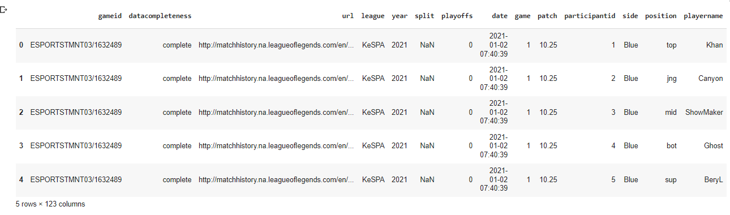
Data Collection:
Dataset used is taken from "https://oracleselixir.com/" where data about all the league of legends higher ranked games are stored. This dataset contains record of every game for a player in columns format so this dataset I have used for our recommendation engine for champions in my some other work . But for using it as a pre-game match prediction dataset we had to convert it into row format where each row contains data of a game played along with details of each player from both teams, their champion, there kills, deaths, assists etc.

Slide 5
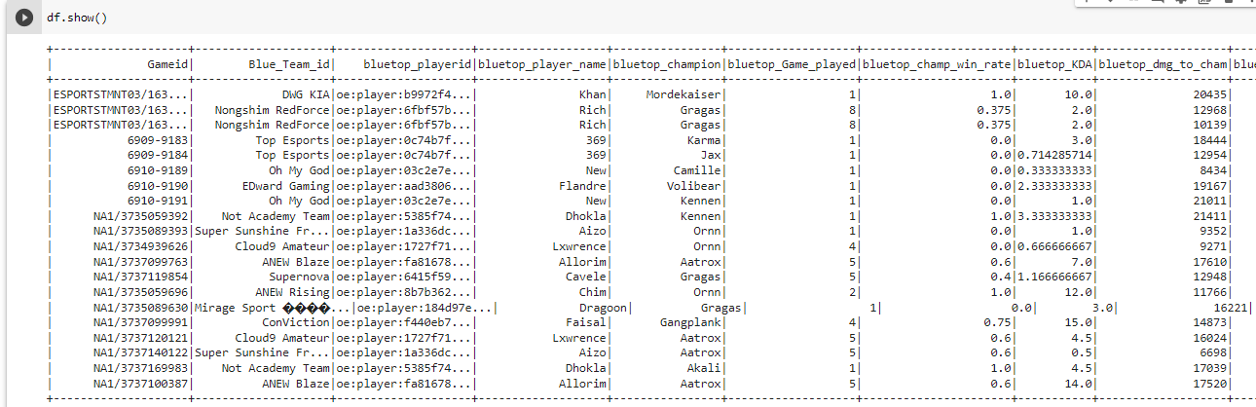
Dataset For Pre-match Game Prediction:
This Dataset contains information about 7425 professional games. Each row is a unique game and having lots of features . Column “Result” is the target, and 1 means blue win while 0 means red win.

Slide 6
Features Description:
Overall, we have 128 features. The various features of the dataset are explained below:
• Game: Game ID • Team ID: Name of the Team. • bluetop_playerid:ID generated by game for a player in blue team at top position • Bluetop_playername:Name of the player in blue team at top position • bluetop_champion: Name of the champion picked by the player in blue team at top position. • bluetop_Game_played: Number of games played with the champion picked by the player in blue team at top position. • bluetop_champ_win_rate: Win rate percentage of the player with a champion picked in blue team at top position. • bluetop_KDA: The Kill Death Assist (KDA) percentage of the player with a champion picked etc. • bluetop_dmg_to_cham: Amount of damage to opposite team champions of the player with a champion etc. • bluetop_goldearned: Amount of gold earned by blue top player • bluetop_monsterkillsownjungle: The no. of monster kills in own jungle by blue top player • bluetop_monsterkillsenemyjungle: The no. of monster kills in enemy jungle • bluetop_goldat10: Amount of gold earned after reaching level 10 by blue top player.

Slide 7
Features Description:
The above-mentioned features have the same meaning for blue (jng, mid, bot, sup) and Red (top, jng, mid, bot, sup)
• Red_team_kills: No. of kills by red team • Red_team_deaths: No. of deaths by red team • blue_ban1: Name of champion banned by blue team in first priority • blue_ban2: Name of champion banned by blue team in second priority • blue_ban3: Name of champion banned by blue team in third priority • blue_ban4: Name of champion banned by blue team in fourth priority • blue_ban5: Name of champion banned by blue team in fifth priority • red_ban1: Name of champion banned by red team in first priority • red_ban2: Name of champion banned by red team in second priority • red_ban3: Name of champion banned by red team in third priority • red_ban4: Name of champion banned by red team in fourth priority • red_ban5: Name of champion banned by red team in fifth priority

Slide 8
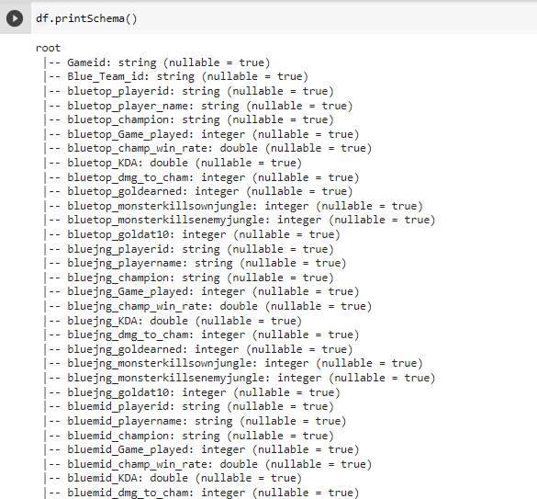
Look at Schemas:

Slide 9

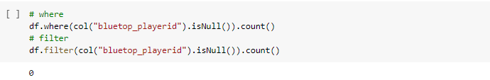
Count how many number of records are there.
Check the missing's:

Slide 10
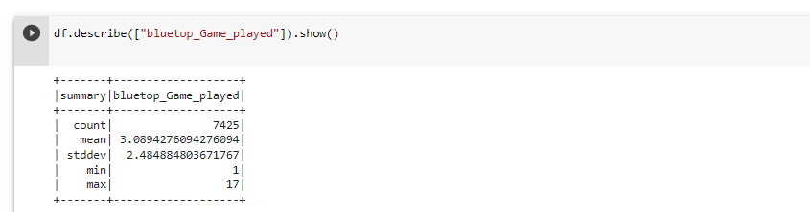
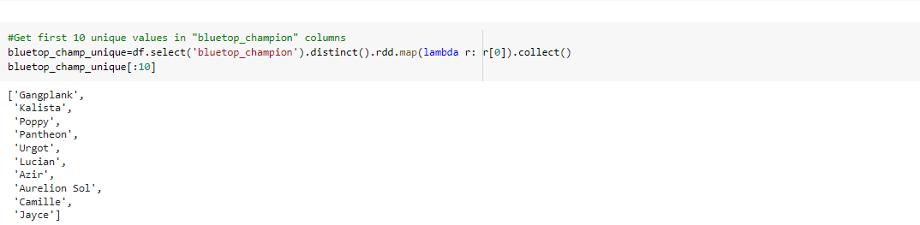
Exploratory Data Analysis

Slide 11
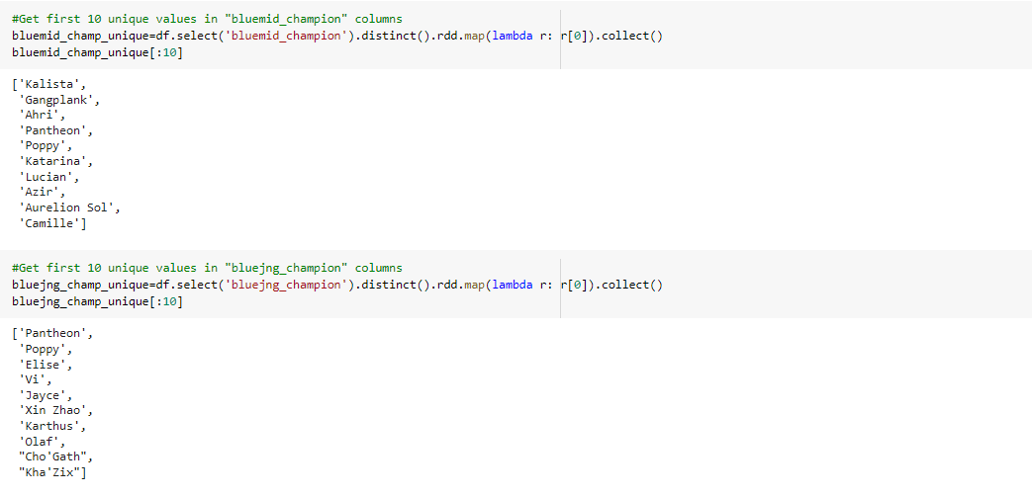
Exploratory Data Analysis

Slide 12
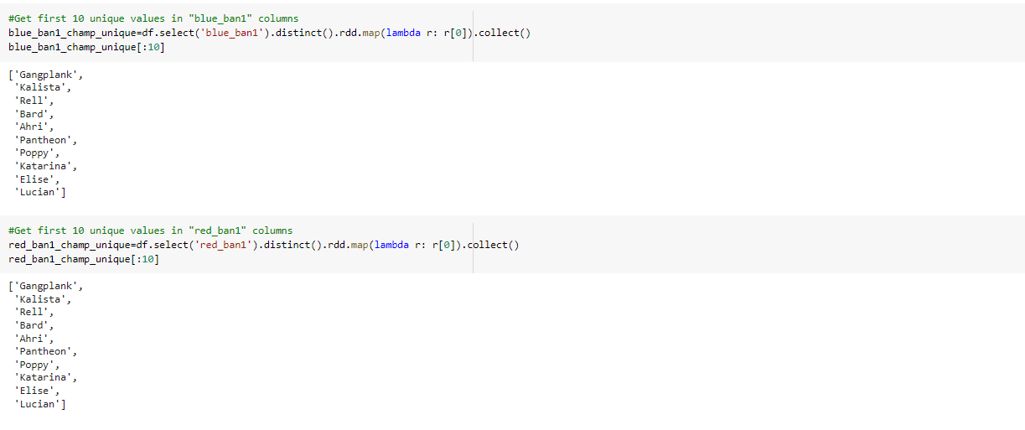
Exploratory Data Analysis

Slide 13
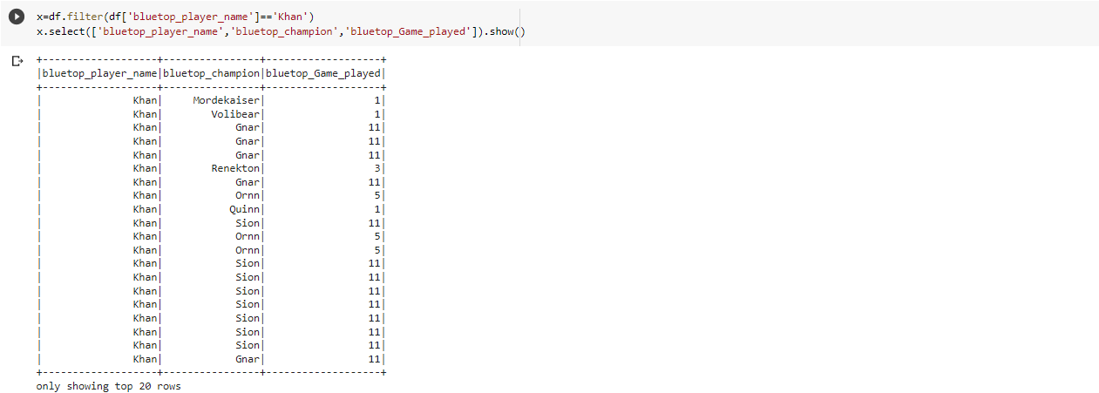
Exploratory Data Analysis: Group by a specific player and see which champions he picked and how many games he played.

Slide 14
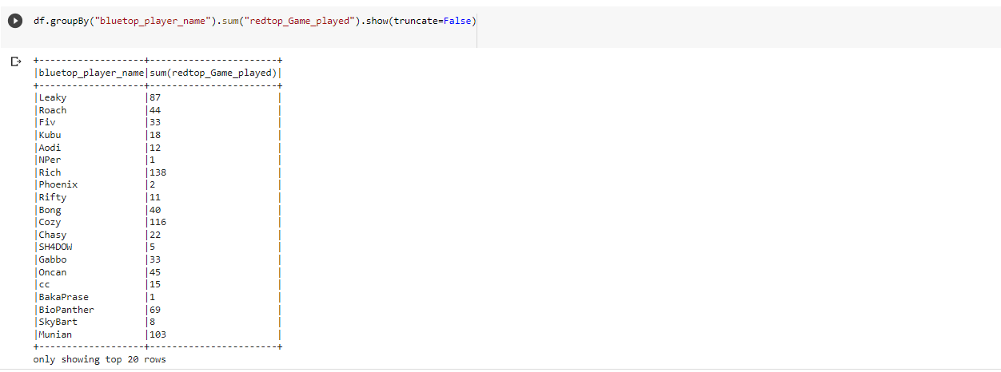
Exploratory Data Analysis: Groupby 'bluetop_player_name" and find total number of games played by them.

Slide 15
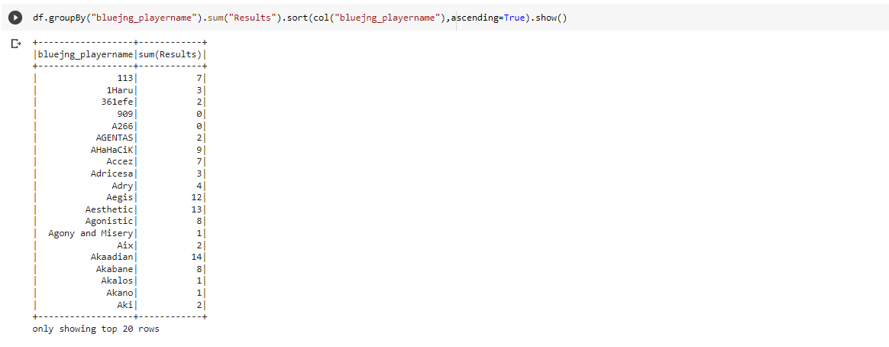
Exploratory Data Analysis: Groupby "bluejng_playername" and find number of games won by him and arranged in ascending order of player name.

Slide 16
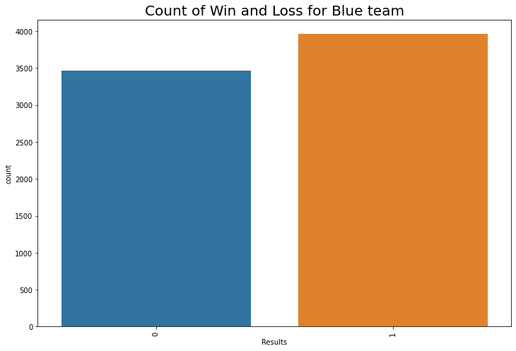
Creating a pandas dataframe for Visualisation:
Visualisation:

Slide 17
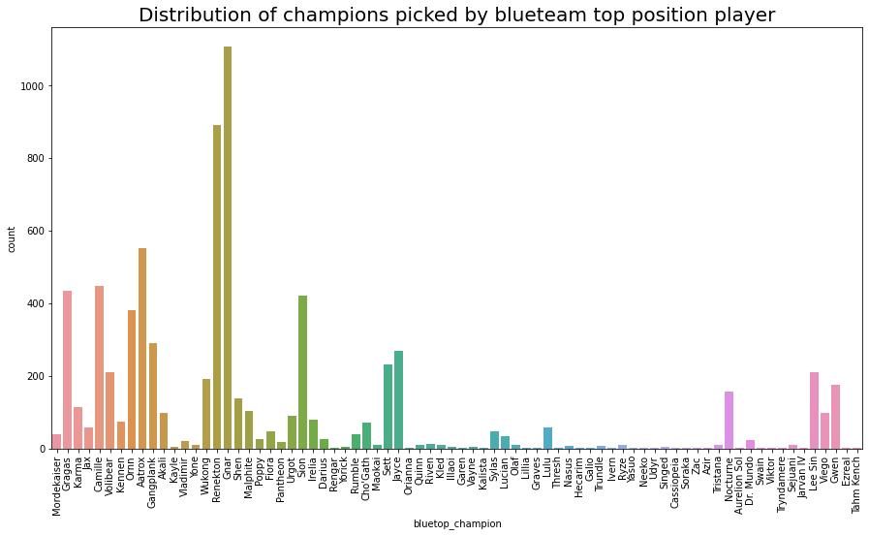
Visualisation:
Plot shows the distribution of champions picked by blue team top position players. We can see "Gnar" and "Renekton" are two most picked champions

Slide 18
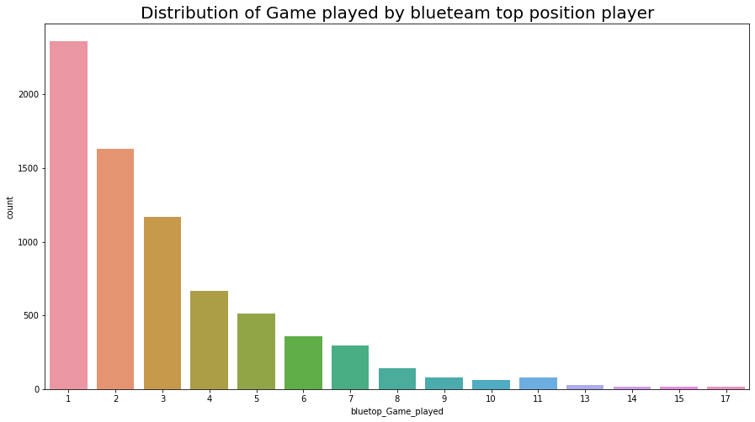
Visualisation:
We can see from above plot,most of the players have played only one or two games in blueteam at top position. It is also because this player may have appeared on other positions and also in other teams as well.

Slide 19
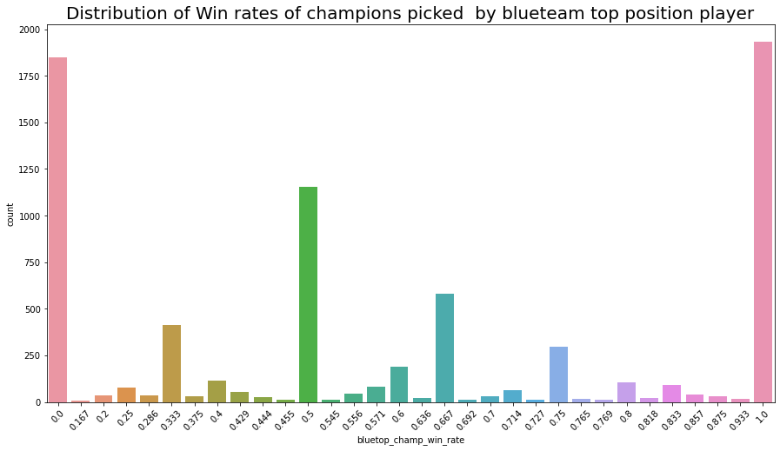
Visualisation:
Plot indicates that most of the players are having winrate in the dataset either 0 or 1.

Slide 20
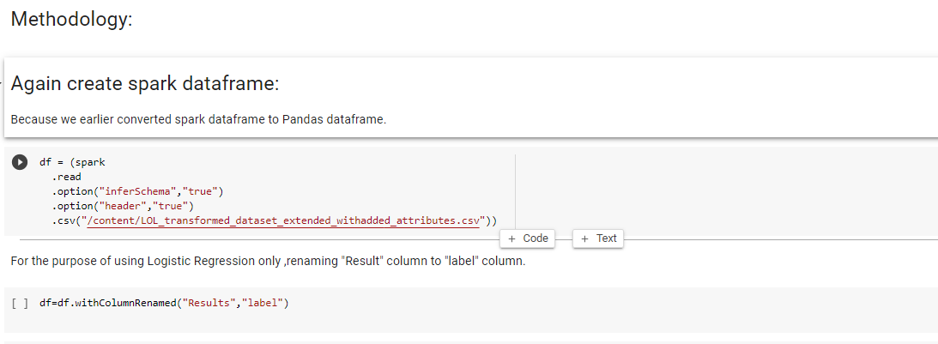

Slide 21
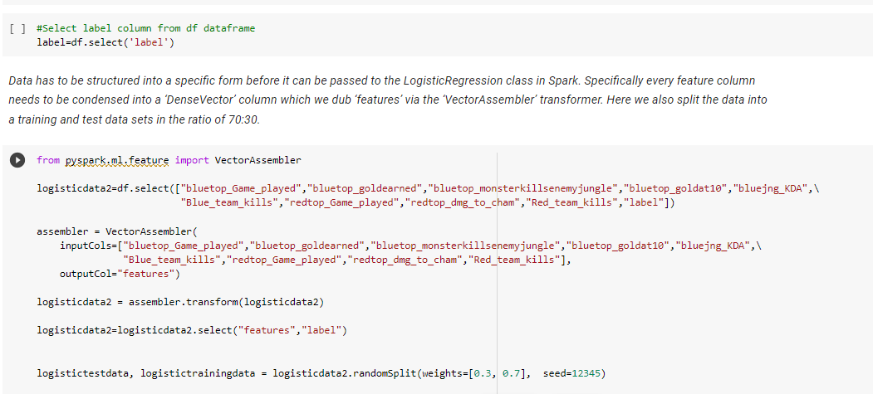

Slide 22
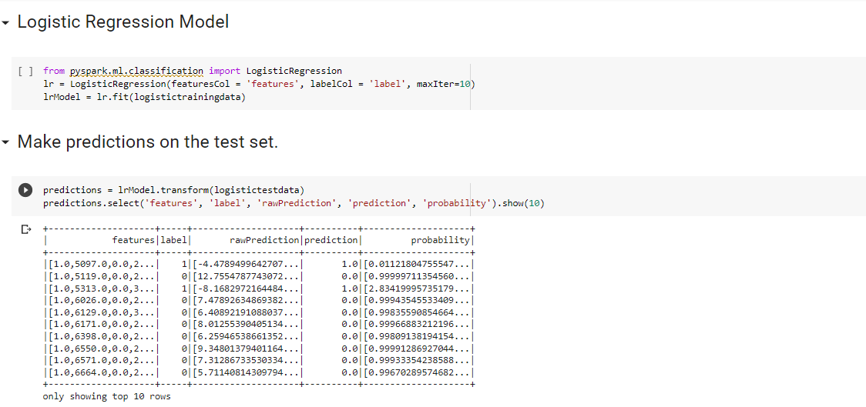

Slide 23
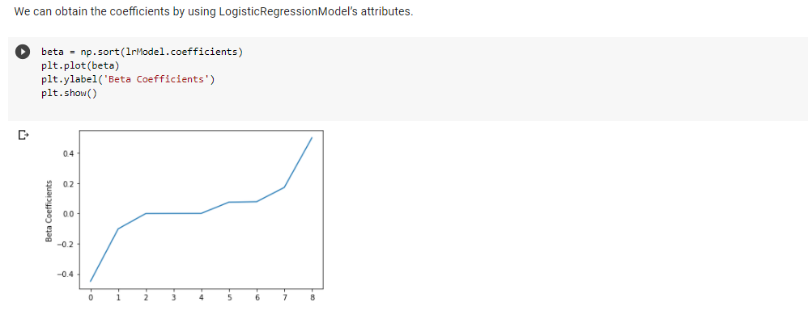

Slide 24
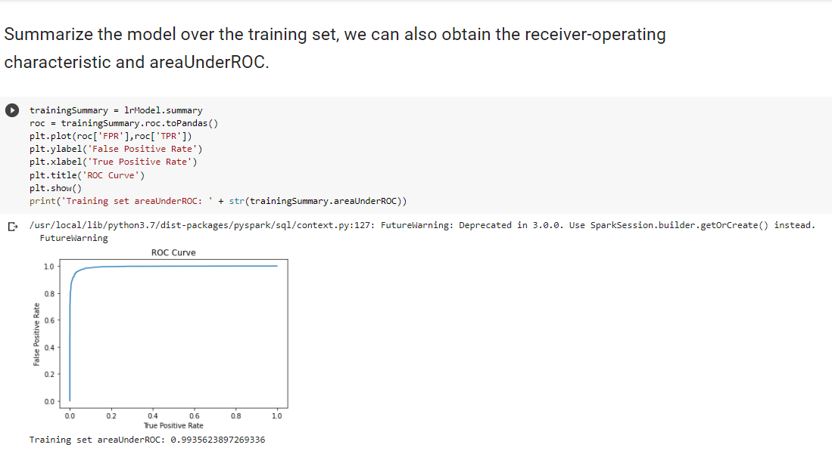

Slide 25
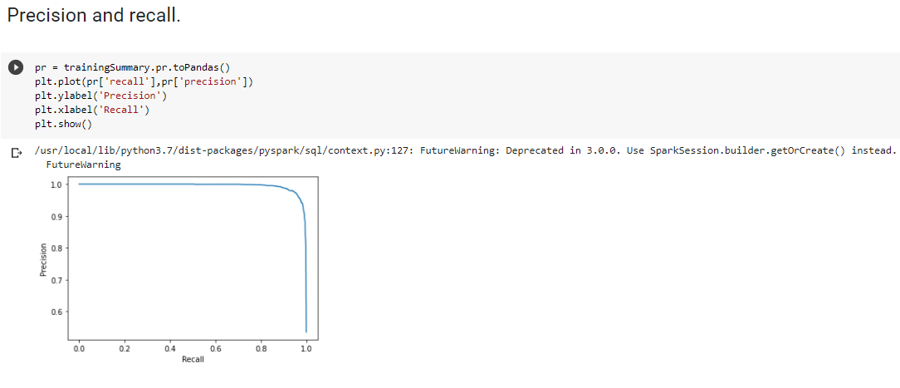
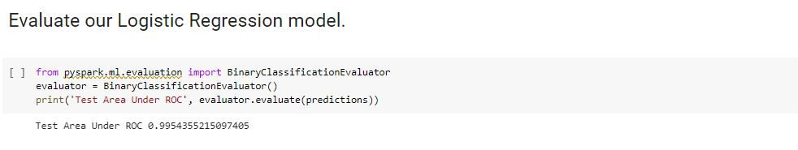

Slide 26
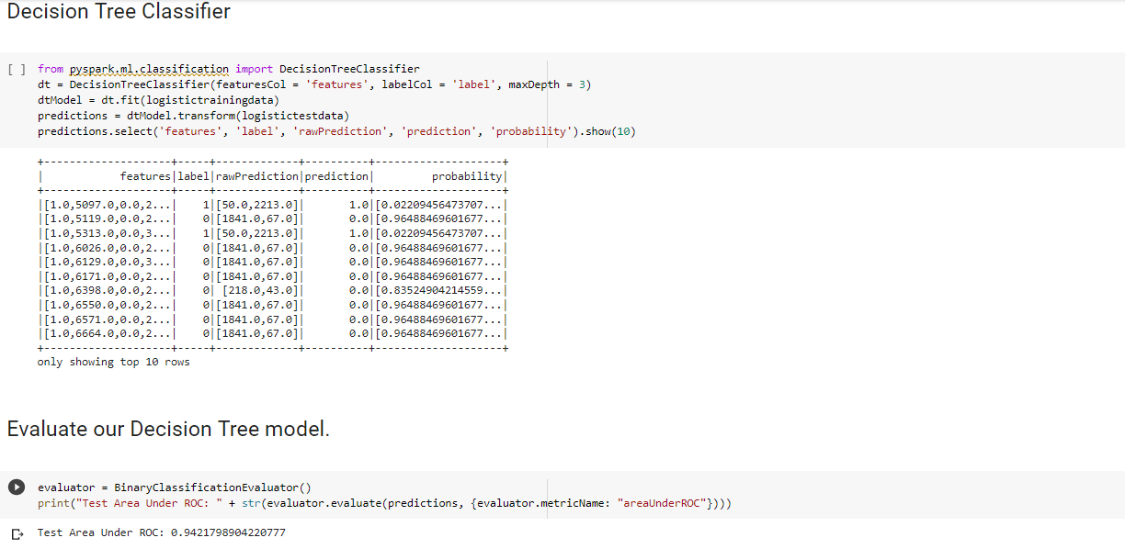

Slide 27
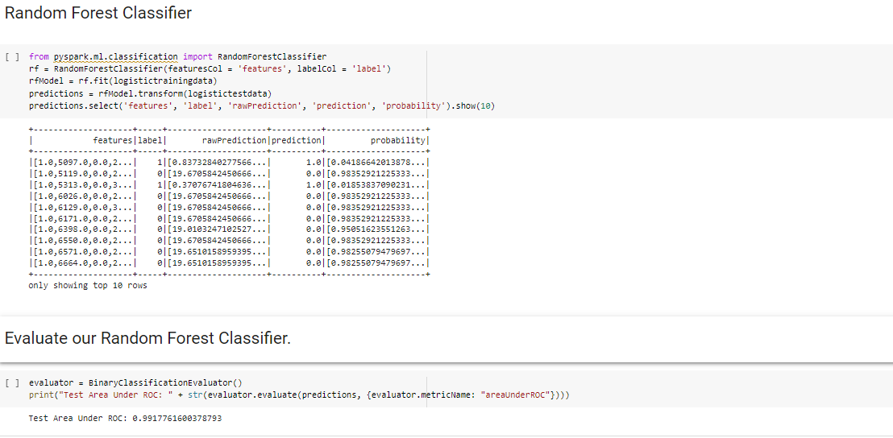

Slide 28
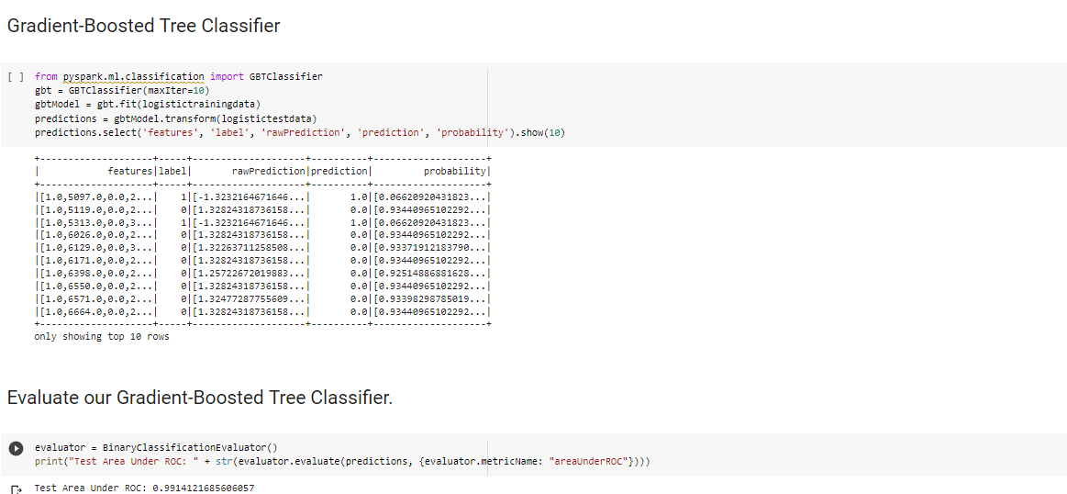

Slide 29
Conclusion:
1.Overall from the results obtained above our model on the basis of few variables taken is preforming very well,as Accuracy,Precision,Recall and Area under ROC everything is very high. 2.Out of all the models tried out ,only Decision tree performed worst having least accuracy,as in our data there is lot of variation in data,and decision tree have high variance,so this is expected. 3.So our model can be used for prematch winner prediction for Game League of Legends,for analysis of team composition for winning a match as winning a match is important for every player participating in the game.

